Slide 1


TRENDS IN THE REAL ESTATE MARKET - USA
Akilan J
DADS - NOV 2024 BATCH

Slide 2

Overview
Clean and preprocess housing data for accuracy and consistency
Analyze property features and pricing trends using EDA
Visualize relationships and patterns in the dataset
Engineer new features to enhance insights and modeling
Identify key factors influencing housing prices

Slide 3
Data Cleaning
&
Pre-pocessing
Null Values
Standardizing Values
Fixing Invalid Values
Check - Outliers

Slide 4
Hypothesis Testing
Does renovation affect price per sq.ft
- Fail to reject - No enough evidence of an affect
Do waterfront properties have higher prices than non-waterfront
- Reject - null hypothesis - Waterfall property - high price than non-waterfall prop

Slide 5
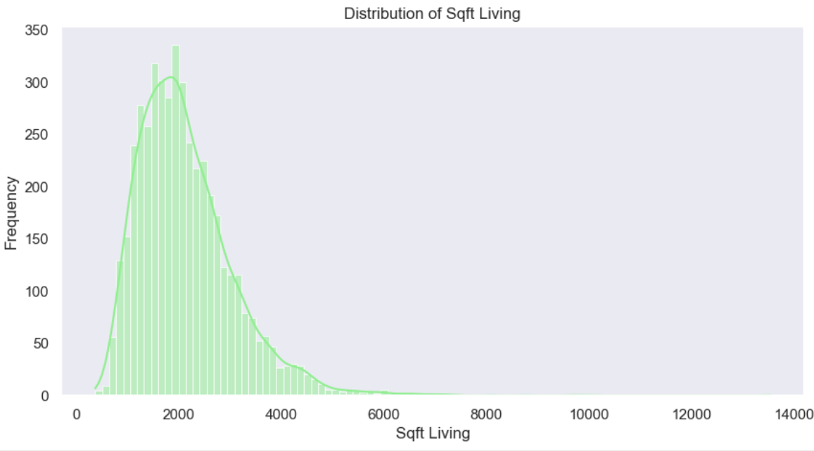
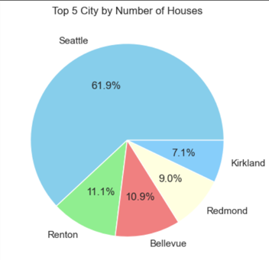
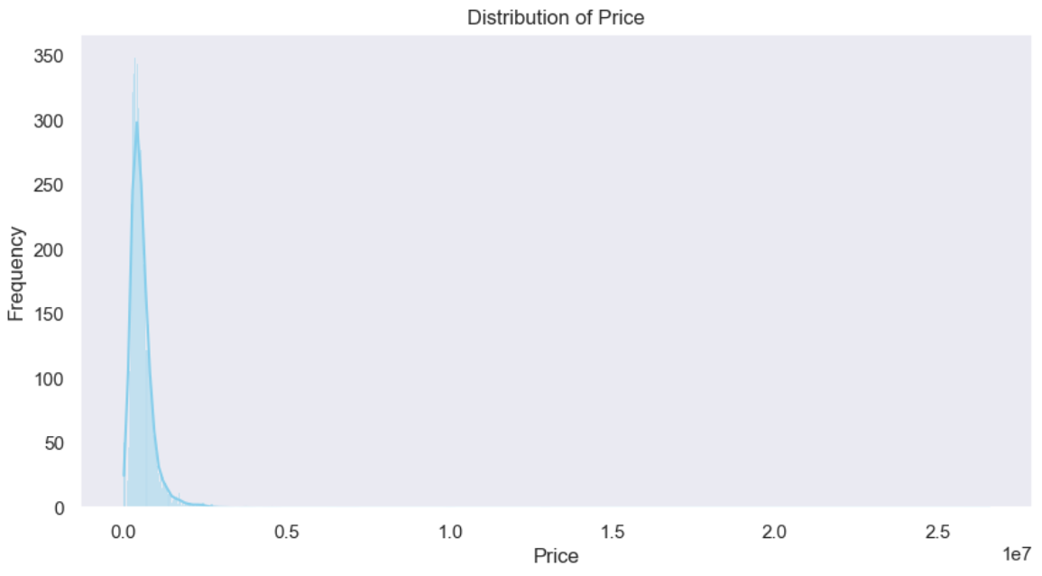
Univariate Analysis

Slide 6
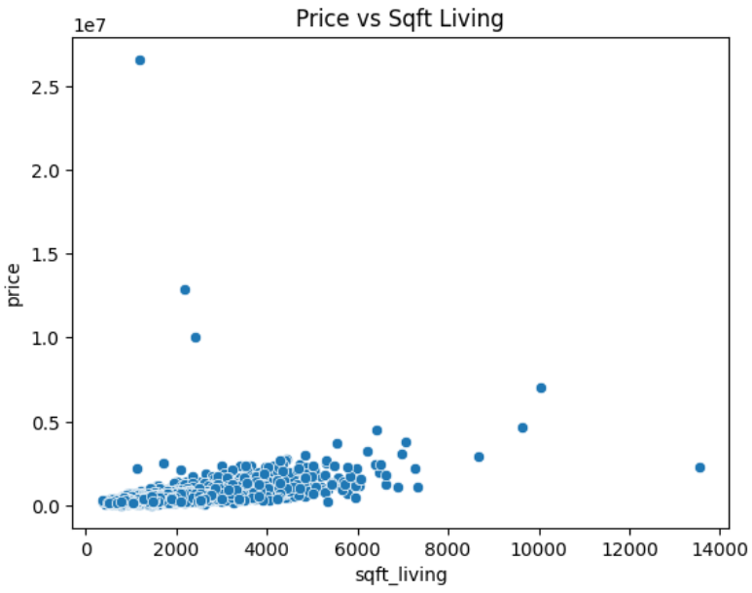
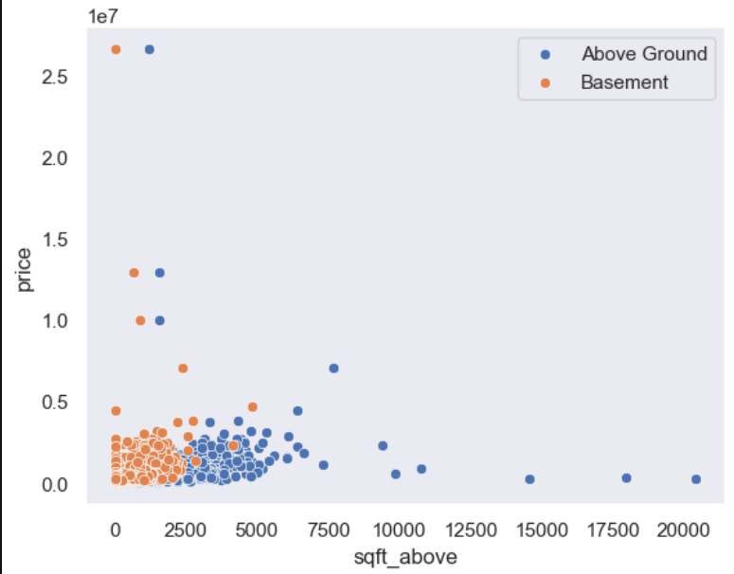
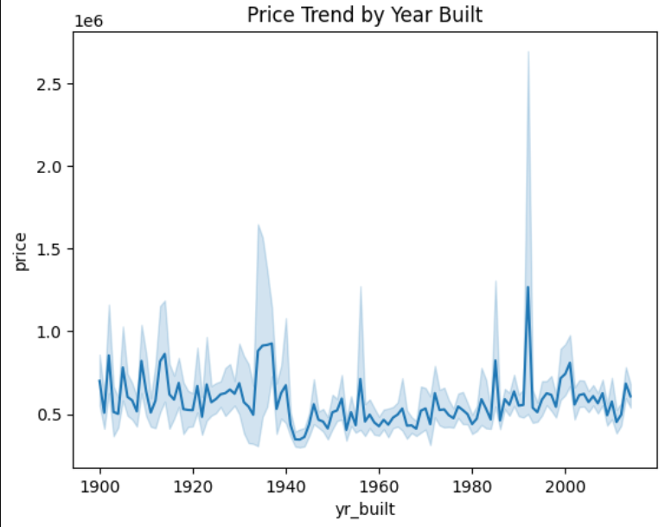
Bi-Variate Analysis

Slide 7
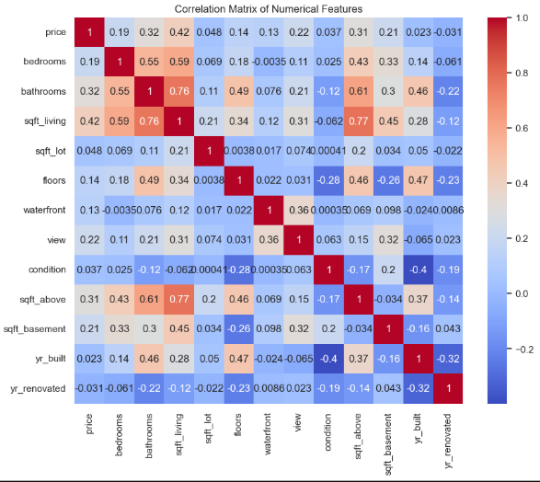
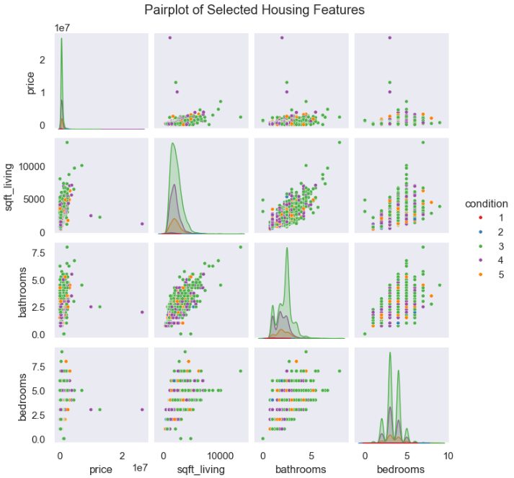
Multivariate Analysis

Slide 8
Insights from Housing Data Analysis
House Size Matters:
Homes with more living space (sq.ft living) tend to have higher prices.
Bigger basements and multiple floors also add value.
Location, Location, Location:
Houses in cities like Seattle, Bellevue, and Redmond usually have higher prices.
Properties with a waterfront view or better scenery (view rating) tend to be more expensive.
Condition and Renovation:
Homes in better condition (rated 4 or 5) fetch higher prices.
Houses that were recently renovated may have a price boost compared to old, untouched homes.
Bedrooms/Bathrooms:
While more bedrooms and bathrooms increase price, the relationship isn't linear — it's about overall livability and layout, not just quantity.
Year Built vs. Renovated:
Newer homes or those renovated recently are priced higher than older, non-renovated ones.

Slide 9
Recommendations:
Residential Property Investment
Invest in regions with rising price trends and active listings – these are signs of healthy residential markets. City’s like – Kirkland, Redmond
Commercial Property
Target stability and visibility: Invest in commercial zones with consistent price or rental income trends.
Eg: City’s like - Seattle, Renton
Avoid low-turnover areas unless entering with a long-term strategy (e.g., redevelopment, leaseholds).
For Real Estate Agencies
Focus in services on high-activity regions (high sales/listing turnover) for faster client conversion.
Use the data to identify emerging markets (e.g., suburbs with rising prices) and develop early presence.
Offer property type specialization (e.g., family homes) based on demand patterns.

Slide 10

That's all
for today!

